Slide 1
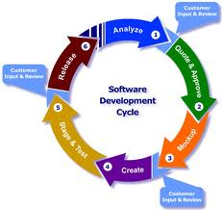
Software Development Life Cycle(SDLC)‏
Overview
Objective
Development Phases
Life cycle Model
Agile SDLC
Strength & weakness
conclusion

Slide 2
1.Overview
It is a process used to develop information systems and user ownership
A framework that describes the activities performed at each stage of a software development project
High quality system
Reaches completion with cost and time
Have various model like Waterfall,spiral,RAD,Agile

Slide 3
2.Objective
Sdlc has Three primary objectives:
-Ensure the delivery of high quality systems
-Provide strong management control
-Maximize productivity

Slide 4
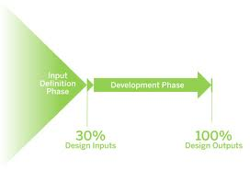
3.Development Phase
The development phase in SDLC are
# Requirement analysis
# Design
# Coding
# Testing
# Operation & Maintainance

Slide 5
Requirement Analysis
It invovles 'breaking down' the system for
* analysis of situation
* analysis of project goals
It can be done by individuals or team members

Slide 6
Design
It takes the initial input
For each requirements design elements will be produced
It describes the software features and includes hierarchy diagrams,screen layout diagrams
The output of ths stage describe the new system as a collection of modules or subsytems

Slide 7
Coding
Modular & subsystem programming code will be accomplished during this stage
It is interlinked with the testing stage
Here overall coding will be tested

Slide 8
Testing
Here the code are tested at various levels
Most common testing are unit, system and user acceptance.
Types of testing are
# White box testing
# Black box testing
# Regression testing

Slide 9
Testing(cont.)‏
# Performance testing
# Integration testing
# Data set testing

Slide 10
Operation & Maintenance
The deployment includes changes and enhancements
Maintaining is the important aspect of SDLC

Slide 11
4.Life cycle models
Different types of life cycle model available are
Waterfall model
Prototyping model
Rapid Application Development(RAD)‏
Spiral model

Slide 12
5.Waterfall model
It is the classical system development model
Requirements-defines needed information,function,behaviour,performance and interface
Design-data structures,software architedtures,interface representations,algorithmic details
Implementation-source code,database,documentation,testing

Slide 13
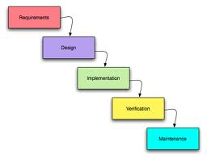
waterfall(cont.)‏
Various stages of waterfall model
0
Row 1
Row 2
Row 3
Row 4

Slide 14
Waterfall(cont.)‏
Strength
Minimizes planning overhaed
Structure minimizes wasted effort
Works well for technically weak or inexperinced staff
Weakness
Inflexible
Only final stage produces documentation
Backing up to address mistake is difficult

Slide 15
6.Prototyping Model
It uses multiple iterations or requirement,analysis,design
After each iteration,the result is evaluted by the customer
When the user is satisfied,the prototype code is brought up to the standards needed for afinal product.

Slide 16
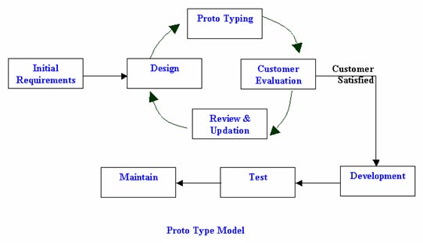
Prototype(cont.)‏

Slide 17
Prototyping(cont.)‏
Strength
Customers can see steady progress
This is useful when requirements are changing rapidly
Weakness
It is impossible to know how long it will take
There is no way to know the no.of iterations will be required

Slide 18
7.Spiral Model
It is risk-reduction oriented model
It breaks the whole projects into mini projects
For projects with risky elements,its beneficial.
Each cycle invovles the same sequence as the steps as the waterfall process model

Slide 19
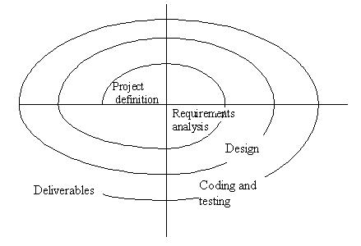
Spiral(cont.)‏

Slide 20
Spiral(cont.)‏
Strength
Early iterations of the project are cheapset
Risk decreases
All iterations meets the project needs
Weakness
Complicated
Require attentive & knowledgable management

Slide 21
8.RAD model
RAD is a concept that products can be developed faster and higher quality through:
- Gathering requirements using workshops
- Prototyping and early,reiterative user testing of designs
- the re-use of software components

Slide 22
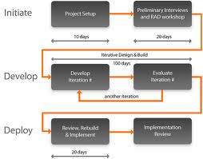
RAD(cont.)‏

Slide 23
RAD(cont.)‏
Strength
Reduces the development time
Reusability
Speed
Easy to work with
Weakness
Require higly skilled engineers
Both the customer & developer should be commited to complete
If it is difficult to modularize,its not work well

